Slide 1
Characterising the use of Prophylactic Health Products (PHPs) by Bangladeshi Shrimp and Prawn Farmers
Doug Tenison-Collins
Supervisors: Francis Murray, Dave Little

Slide 2
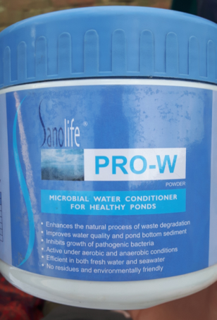
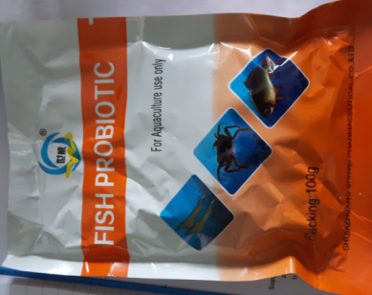
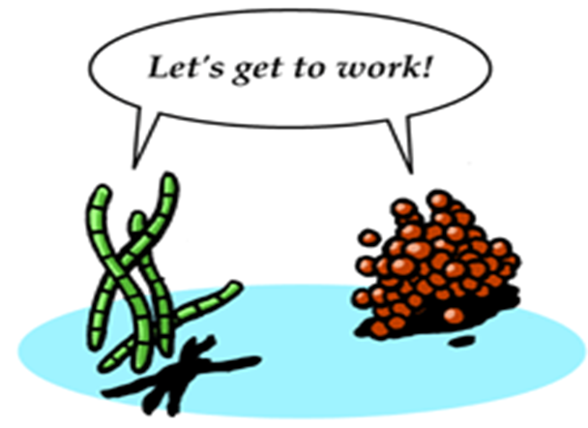
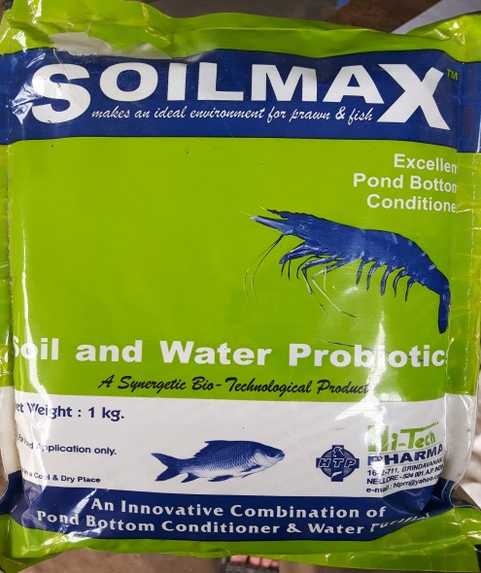
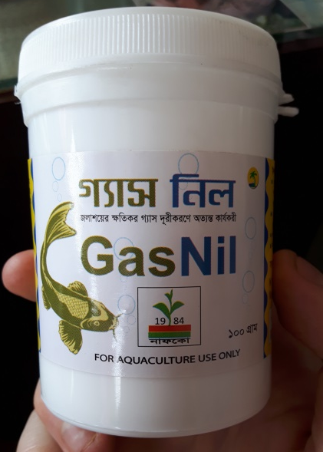
What are PHPs?
Products to prevent disease
Pond/organism microbiome
Immunomodulation
Notes:
Probiotics – live microorganisms that when administered in adequate amounts confer a health benefit to the host¹
Prebiotics – non-digestible food ingredients that beneficially affect the host by selectively stimulating growth of beneficial bacteria
Beta glucan – phenoloxidase activity, phagocytosis and bactericidal activity
Organism → Immunomodulation, Gut barrier function, Competitive exclusion
Pond environment → Oxidation of wastes

Slide 3
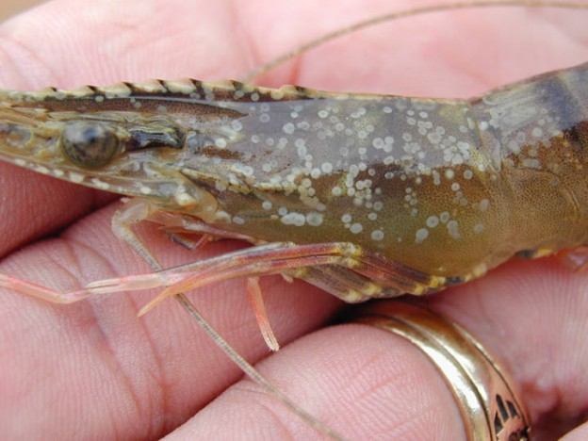
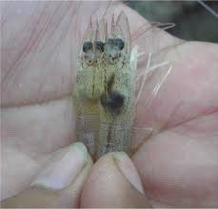
Why focus on PHPs?
Recurrent pandemics
Shrimp particularly susceptible
Antibiotics increasingly limited
Vaccination difficult for crustaceans (decapods)
Farmers reliant on manufacturer claims
bioaqua.vn
FAO, 2013
Notes:
Pandemics → WSS, EMS
Shrimp particularly susceptible, why chose it
Mostly cash crop export orientated, higher pressure
Antibiotics more limited due to resistance and risk of bans
Reliance on manufacturer claims means susceptible to poor product quality assurance
http://www.fao.org/docrep/018/i3422e/i3422e.pdf
http://bioaqua.vn/wp-content/uploads/WSSV-624x468.jpg

Slide 4
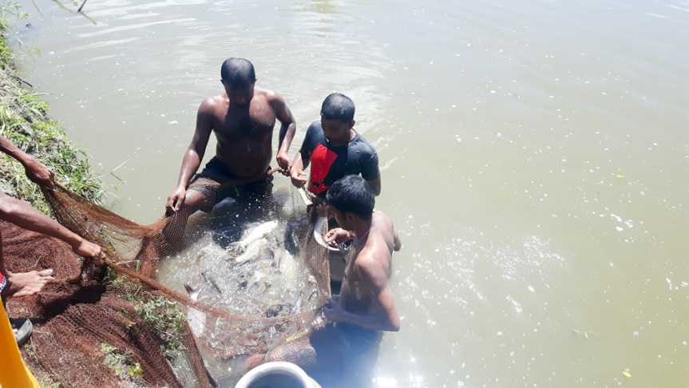
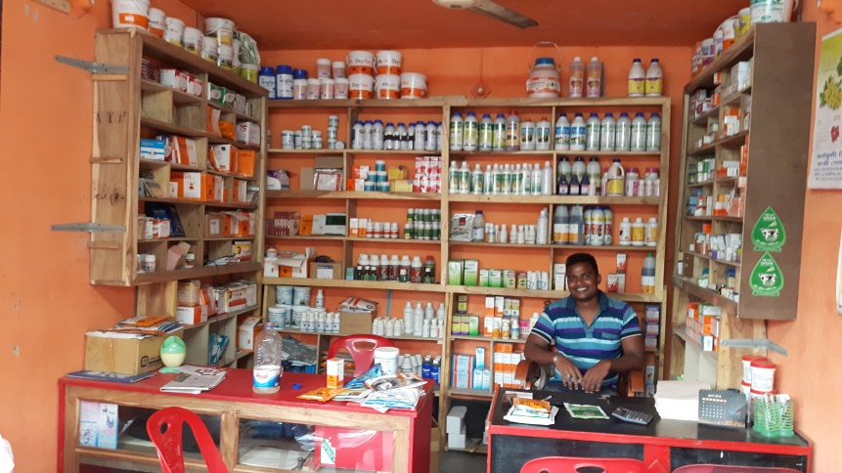
Research questions
For small-holder farms at different levels of intensification:
What are current patterns & historic trends in PHP use?
How affected by farmer capacities, motivations and constraints?
Evolution of PHP supply chain structure and regulation?
Influence on quality assurance, access to PHPs and information availability

Slide 5
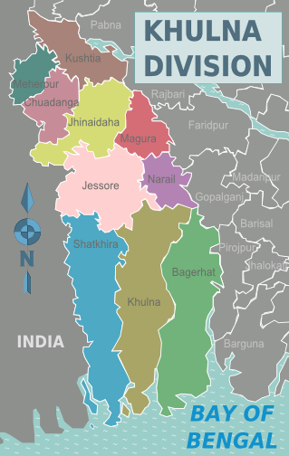
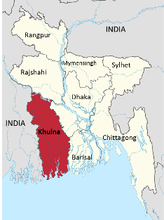
Study Area
P. monodon (“shrimp”)
M. rosenbergii (“prawn”)
78% of national production¹
Predominantly smallholders
Wikipedia
Wikipedia
¹FRSS, Department of Fisheries (2014) Fisheries Statistical Yearbook of Bangladesh 2013-2013, Vol 30, BG Press
Notes:
https://upload.wikimedia.org/wikipedia/commons/thumb/3/34/Khulna_in_Bangladesh.svg/2000px-Khulna_in_Bangladesh.svg.png
https://en.wikipedia.org/wiki/Khulna_Division#/media/File:Khulna_Division_districts_map.p
Put Bangladesh thereng
Take colour

Slide 6
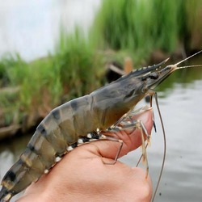
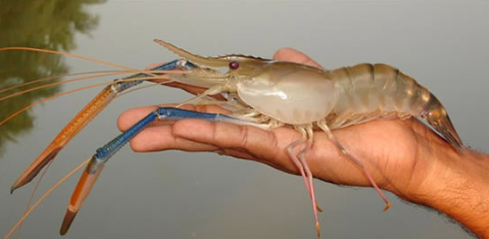
“Shrimp” (Penaeus monodon)
“Prawn” (Macrobrachium rosenbergii)
imimg.com
FAO
Notes:
http://3.imimg.com/data3/BO/SF/MY-5605953/black-tiger-prawns-250x250.jpg
http://www.fao.org/uploads/pics/GiantF1.jpg
Caption photos with spp.
Make obvious difference between
Merge with previous slide. No clutter,

Slide 7
Study Design: sequential exploratory mixed-methods
Qualitative phase
Key informant (n=6) and semi-structured interviews (n=26) along supply chain
Develop farmer questionnaire
Based on qualitative findings
Testing generalisability of qualitative findings
10 shrimp, 10 prawn, 10 shrimp-prawn
6 intensive shrimp
Product inventory
Quantitative phase
Notes:
Mixed methods → sequential exploratory
Good for when variables unknown, and when measuring perceptions and behaviours as not easy quantitatively
30 farmers randomly selected
Sample sizes of KI,SS interviews

Slide 8
Focal communities (“clusters”)
Using pre-existing sample frame developed for SEAT project (2010)
3 surveyed under the SEAT project:
Semi-intensive² shrimp (SI-S)
Intensive-lower prawn (IL-S/P)
Intensive-lower shrimp-prawn (IL-P)
1 new group, established since SEAT:
Intensive-higher shrimp (IH-S)
Low intensity
Higher intensity
² Edwards, P., Pullin R.S.V, Gartner, J.A. (1988) Research and Education for the Development of Integrated Crop-Livestock-Fish Farming Systems in the Tropics, ICLARM Studies and Reviews 16, International Center for Living Aquatic Resources Management, Manila, Philippines
Notes:
According to FAO definitions
Extensive culture systems receive no intentional nutritional inputs but depend on natural food in the culture facility, including that brought in by water flow e.g., currents and tidal exchange.
Semi-intensive culture systems depend largely on natural food which is increased over baseline levels by fertilisation and/or use of supplementary feed to complement natural food.
Intensive culture systems depend on nutritionally complete diets added to the system, either fresh, wild, marine or freshwater fish, or on formulated diets, usually in dry pelleted form.
Inherited sample frame, related to export orientated, farm scale not intensity, cluster based to increase generalisability

Slide 9
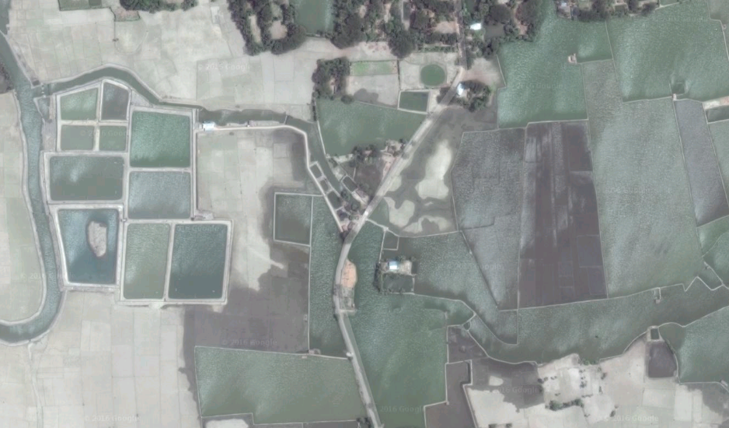
Intensive-higher shrimp
Majority small & recently established
approx. 67 farms total
All supplied & supported by same multinational company
Google maps
Notes:
67 farms comes from DoF lists

Slide 10
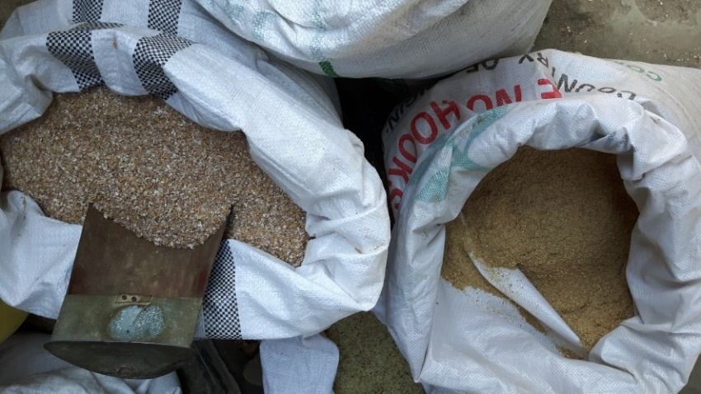
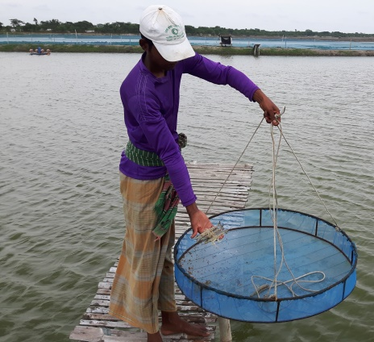
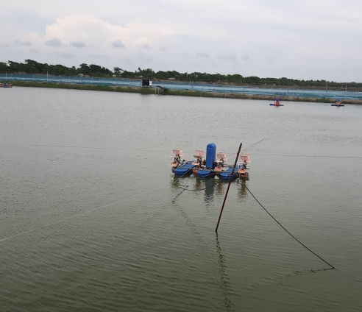
Indicators of intensity
Cluster | Mono/polyculture | Aerate? | PCR tested PL | No. of stockings | No. of harvests [method]
SI-S | Polyculture | No | No | 10-20 | 10-20 [traps]
IL-P | Polyculture | No | No | 1-5 | 1-5 [cast net]
IL-SP | Polyculture | No | No | 1-5 | 1-5 [cast net]
IH-S | Monoculture | Yes | Yes | 1 | 1 [drain pond]

Slide 11
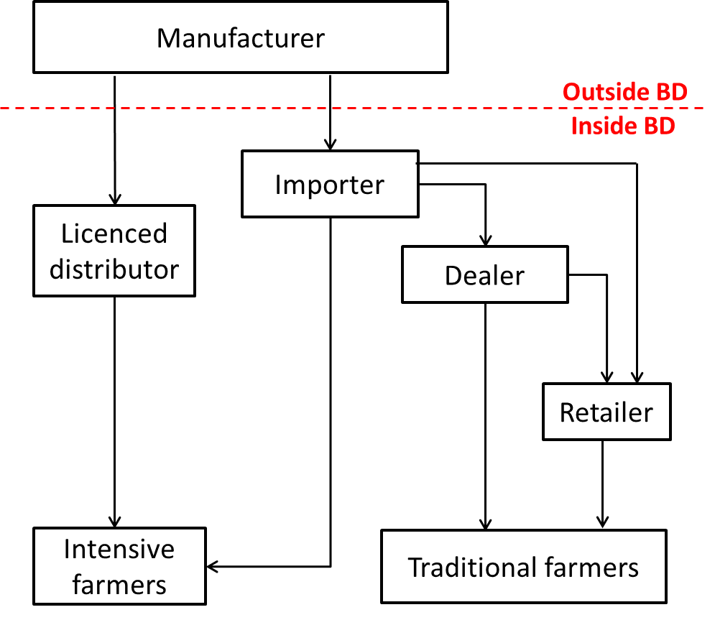
Supply chain
7 main importers
Diverse business interests
Train shops and farmers
No regulation
Notes:
No regulation on probiotics etc. as yet apparent
Picturews, big font, key notes, logos

Slide 12
Intensification trends – “CM-S-ASI”
Culture months and survival adjusted stocking index
Accounts for differences in survival
Negates differences in stocking frequency
Allows comparisons across systems
More reliable vs. feed or fertilisers
$$CM−S−ASI=Percentage Survival \left(\frac{Total stocked}{culture duration}\right)$$

Slide 13
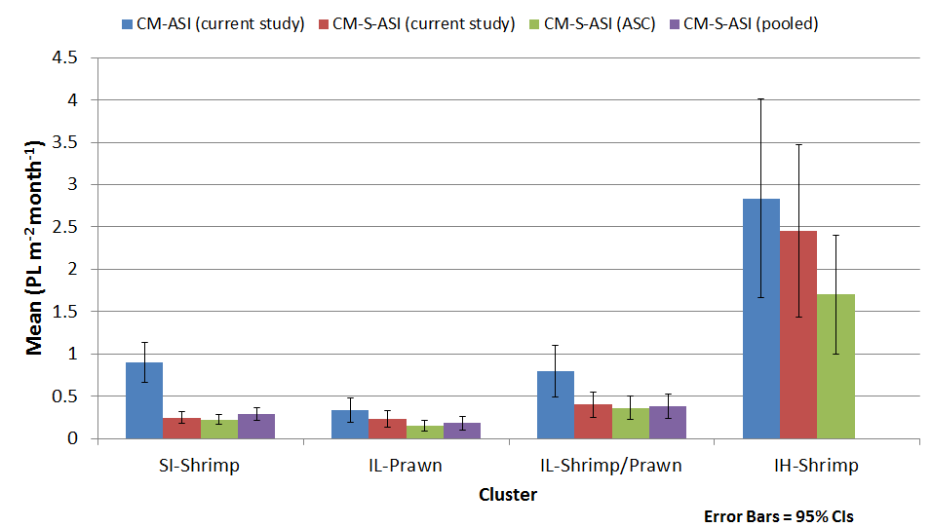
Intensification trends – “CM-S-ASI”

Slide 14
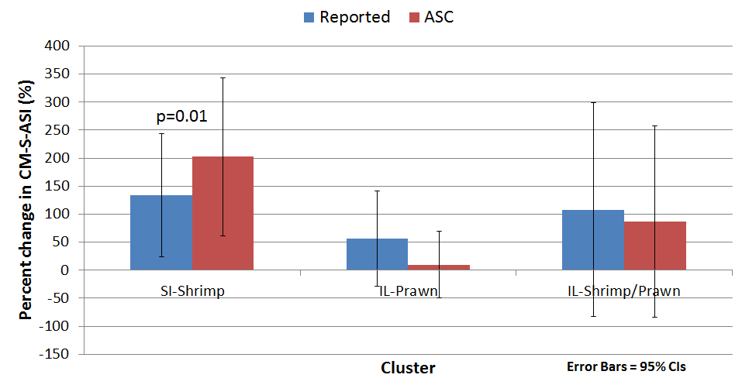
Intensification trends – “CM-S-ASI”
p=0.01
Notes:
Only 1-SI-S significant difference

Slide 15
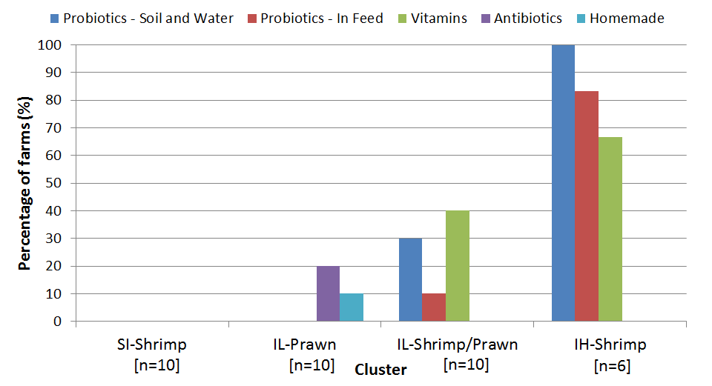
% PHP usage by cluster
Notes:
NB low antibiotic use
N shows number of farms that are using at least one PHP/product
Change to percentage

Slide 16
Percentage of each PHP type by cluster
n=3
n=10
n=35
Notes:
Might not need

Slide 17
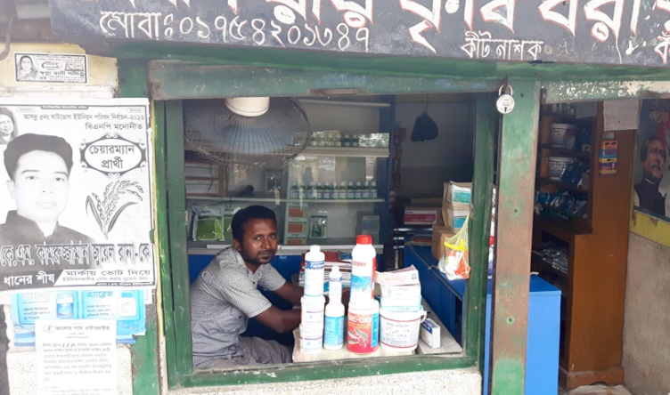
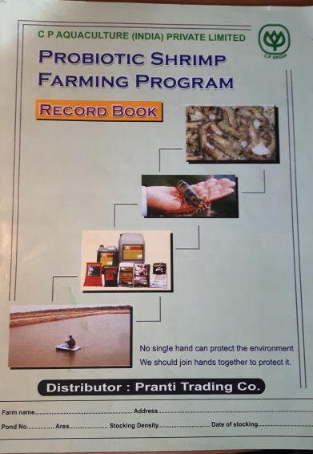
Farmer capacities and motivations
Very poor diagnostic capacity
Heavy reliance on chemical shops or company
Diagnostic support
Product recommendations
Supported by questionnaire results
Intensive-higher shrimp
Older and/or larger farms more independent
Notes:
5/6 recommendation from shopkeeper
All going to same shop
Proximity to shops, training/trust in shopkeeper
More about motivations, observations didn’t do fully

Slide 18
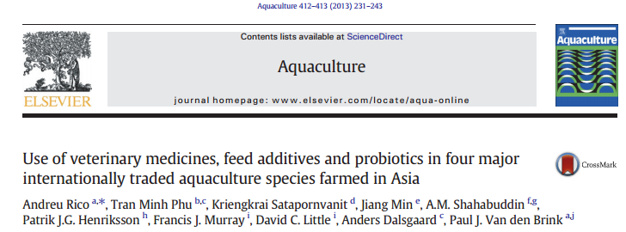
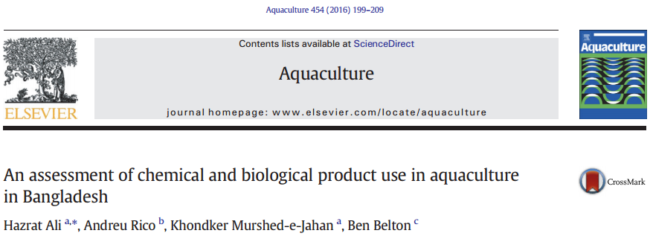
Previous studies
Rico et al. (2013) & Ali et al. (2016)
Surveyed shrimp, shrimp-prawn and prawn farms
Both found low probiotic and feed additive usage
Highest in shrimp-prawn and prawn systems
Rico et al. working as part of SEAT project
Notes:
Not just PHPs
Low probiotic (2.3-9.7%) & feed additive (0.97-22.87%) usage
Highest in shrimp-prawn and prawn

Slide 19
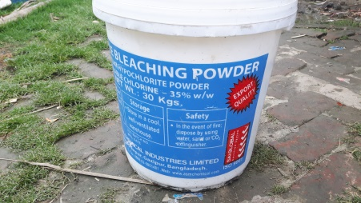
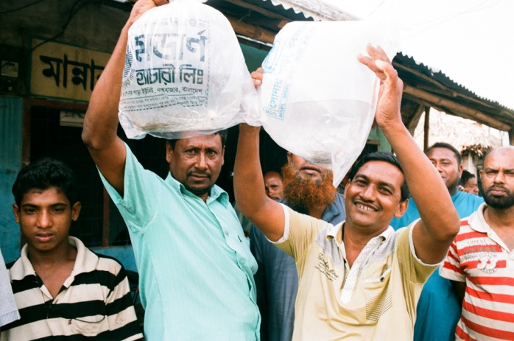
Intensification vs. PHP use
Little change since 2011
Adaptation in other aspects?
Future PHP use?
Influence of new intensive farms?
Notes:
Adaptation despite higher stocking → more disinfectants, frequency of stocking, changed seed source

Slide 20
Conclusions
Evidence of intensification – sustainable?
Rates of PHP use remain low
Reliance on companies and/or shops across systems
Future work should establish efficacy and effective regulation/quality assurance

Slide 21
Points to improve
Develop supply chain aspects
Greater focus on farmer motivations
Improved qualitative methods
Refine the intensive farm sample frame
Larger sample sizes

Slide 22
IMAQulate and INSPIRE projects
IMAQulate
INSPIRE
Bangladesh, India, Kenya
Characterise available PHPs
Assess
efficacy – in field and lab
costs & benefits
Training and regulation
Strategic partnerships between UK and South Asian Universities
Working in close collaboration with MSc students from NSTU
Building capacity of staff and students at both institutions

Slide 23
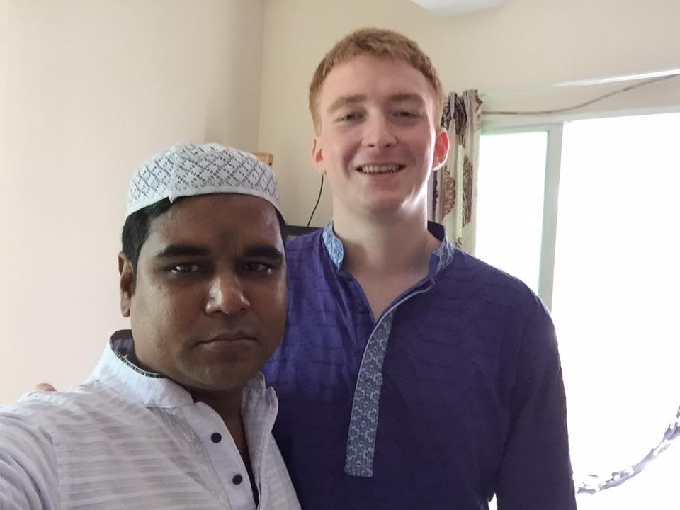
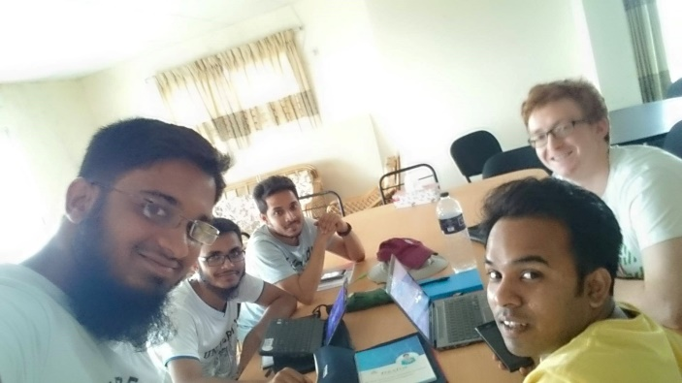
Acknowledgments
Dr Francis Murray, Abdullah Al Mamun, Professor David Little, Meezanur Rahman
Mehedi Hasan Tanmay and Hazrat Ali for their tireless support in the field
Akram Ullah, Noman Siddiqye, Mezbaur Rahman and everyone at NSTU
The British Council and DFID for funding support

Slide 24
References
Ali, H., Rico, A., Murshed-e-Jahan, K., & Belton, B. (2016). An assessment of chemical and biological product use in aquaculture in Bangladesh. Aquaculture, 454, 199–209. doi:10.1016/j.aquaculture.2015.12.02
Rico, A. et al. (2013). Use of veterinary medicines, feed additives and probiotics in four major internationally traded aquaculture species farmed in Asia. Aquaculture, 412-413, 231–243. doi:10.1016/j.aquaculture.2013.07.028

Slide 25
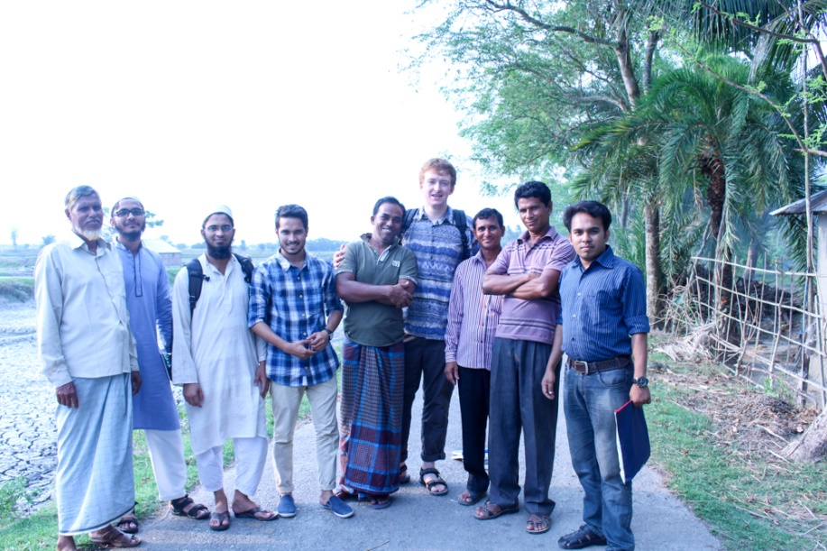
Any questions?

